Slide 1
Digital Portfolio
STUDENT NAME: Mithun G
REGISTER NO/NMID:212403730/asunm1453212403730
DEPARTMENT: BCA
COLLEGE: :Vel Tech Ranga Sanku Arts College/University of Madras

Slide 2
PROJECT TITLE
STUDENT DIGITAL PORTFOLIO USING FRONT AND DEVLOPMENT

Slide 3
AGENDA
Project Overview
End Users
Problem Statement
Tools and Technologies
Portfolio design and Layout
Features and Functionality
Results and Screenshots
Conclusion
Github Link

Slide 4
WHO ARE THE END USERS ?
1.students:
Use it for academic projects and resumes.
Helps showcase skills learning in a practical format.
2.Job seekers:
Share their work with recruiters.
Demonstrate technical ability and creativity.
3.Freelancers:
Present projects or prototypes to clients.
Aids in securing freelance gigs by showing live examples.
4.professionals:
Highlights work experience and achievements.
Build portfolios and dashboards for professional growth.

Slide 5
PROJECT VIEW
Developed a personal portfolio website to showcase my works and skills.
Build using HTML for structure, CSS for styling , and JavaScript for interactivity.
The site features key sections: Home, About, Projects, and contacts.
Clean and modern UI using the Poppins font and color palette(#f8f9fa,#1a0b0b).
Navigation bar allows smooth access to different sections of the page .
Introduction basic interactivity using JavaScript (Ex. form submission alert).
Designed for responsiveness and simplicity-ideal for both desktop and mobile users.
Highlighted personal branching with, roles, and a “view my work” call-to-action.
Aimed at demonstrating front-end-development skills and UI/UX understanding.

Slide 6
TOOLS AND TECHNIQUES
HTML is a structure(Page, Sections).
CSS used for styling(Colors, Layout, Responsiveness).
JAVASCRIPT is a interactivity(navigation Menu, Animation, form validation).
CODERPEN and hosting platform(GitHub pages).

Slide 7
PORTFOLIO DESIGN AND LAYOUT
1.Sections:
Hero section
Project section
Contact section
Header section
Footer section
About section.
2.Home / about me.
3.Skills.
4.contact.
5.Responsive layout(Mobile+Destop view).

Slide 8
FEATURES AND FUNCTONALITY
Navigation bar with smooth scrolling.
Personal branding.
Project showcase with images/details.
Responsive design.
CSS styling & resets.
Animation/Transition.
Sematic HTML.
Form handling with JavaScript.

Slide 9
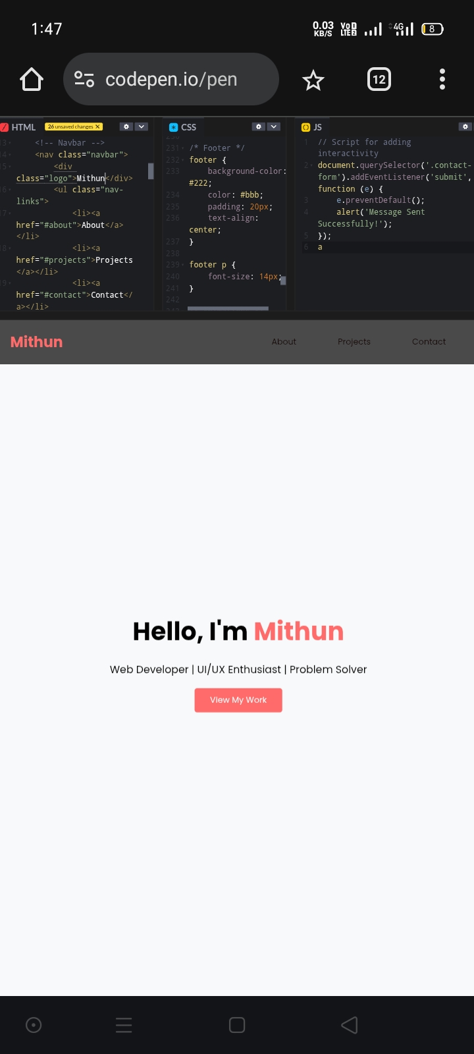
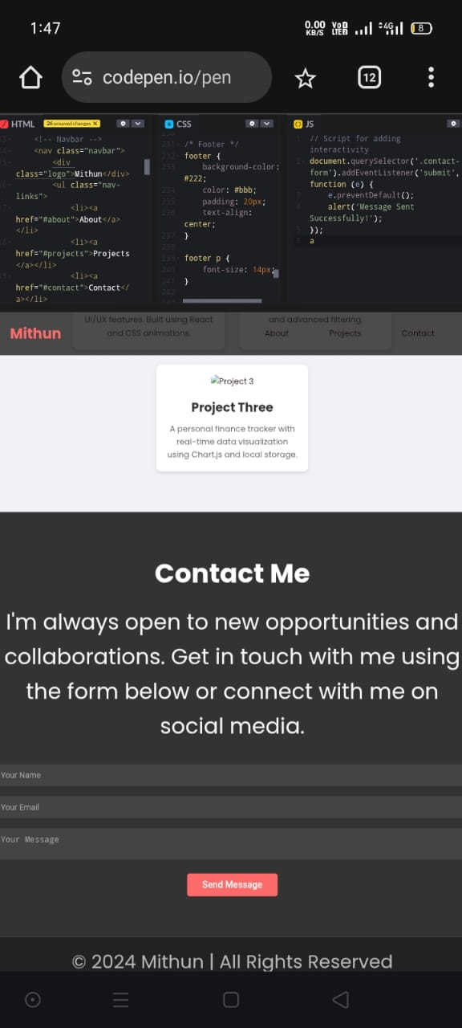
RESULTS AND SCREENSHOTS

Slide 10
CONCLUSION
The digital portfolio is a modern way to present yourself professionally online.it demonstrate not just content but also your ability to design and delay a product.

